Slide 1
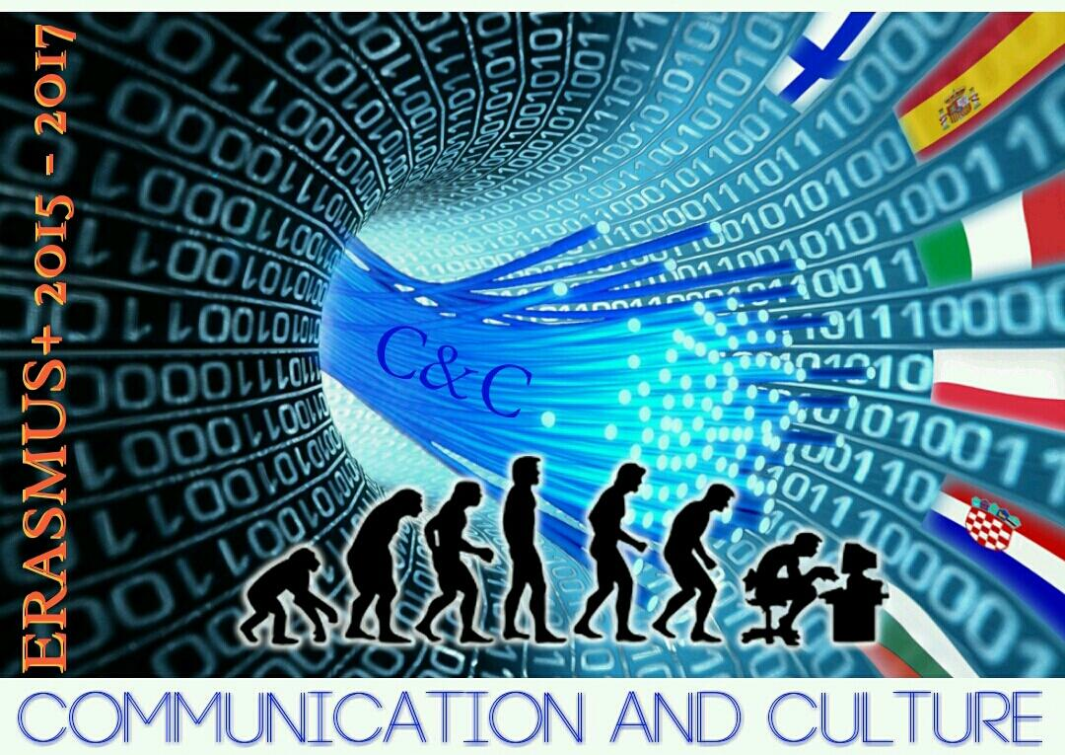
THE MASK
IN
ANCIENT TIME

Slide 2
The masks as a form of nonverbal communication
The mask is an artifact that is worn to cover the entire face or only the eyes. It was used since prehistoric times for religious rituals, but it was also an important element in theatre performances or popular festivals such as Carnival. In Italy there is a rich tradition of regional masks.

Slide 3
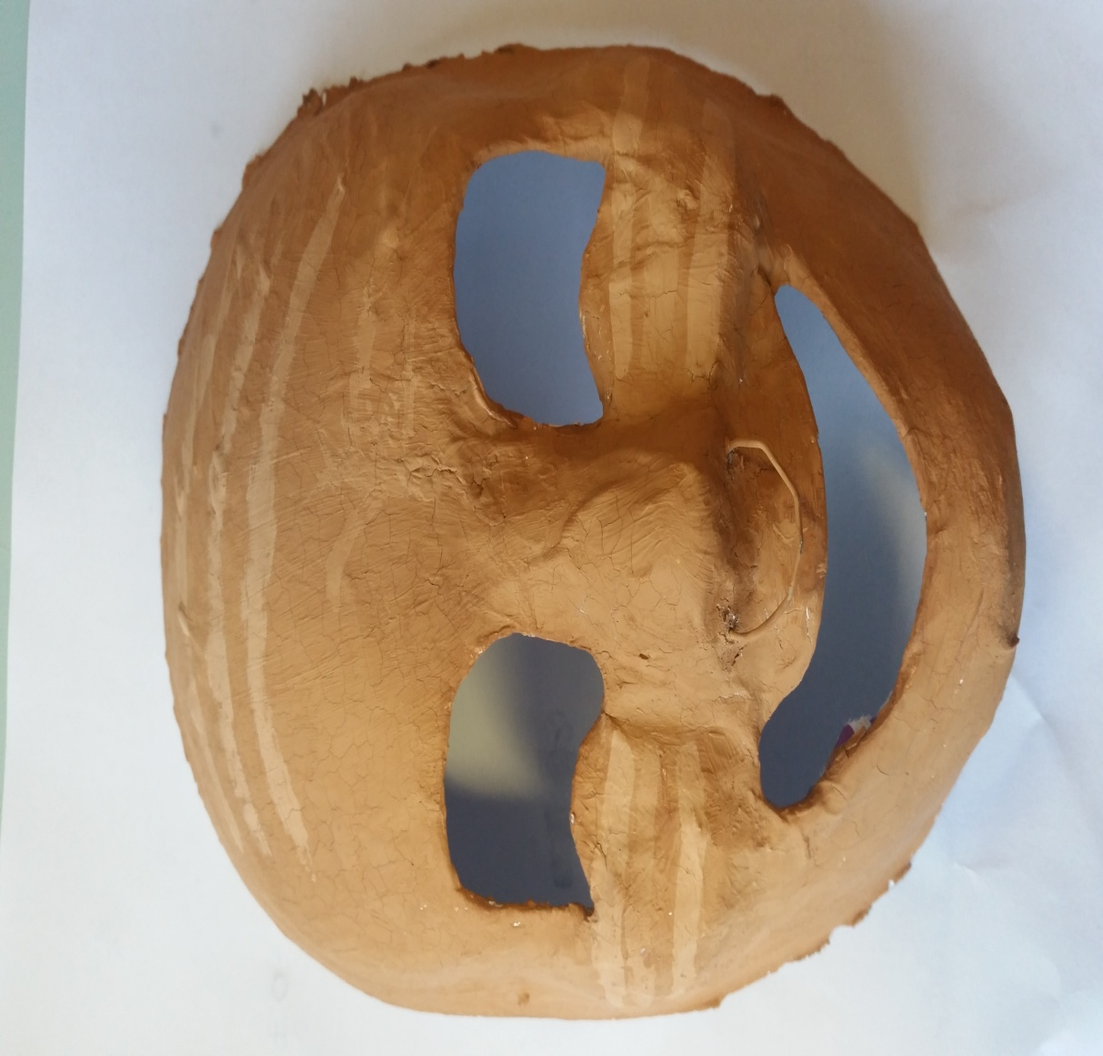
THE GREEK MASK
In the third millennium B.C. Greek civilization spread throughout the Mediterranean area. Greek masks were used in theatre performances to communicate feelings and emotions, they were worn by people during popular festivals.

Slide 4
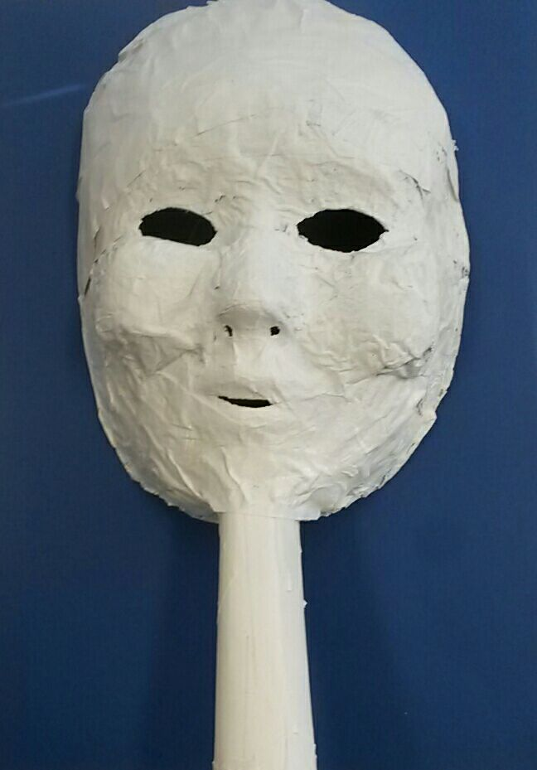
The ROMAN MASK
The origins of the Roman mask date back to the tenth century B.C. It was worn by Romans during religious festivals, public entertainments, rituals, sacrifices, and dances.

Slide 5
The PALEOLITHIC MASK
Early Paleolithic masks are undoubtedly related to the world of nature. The first one dates back to 30.000 years ago. Primitive men used the mask to hunt or for magic rituals.

Slide 6
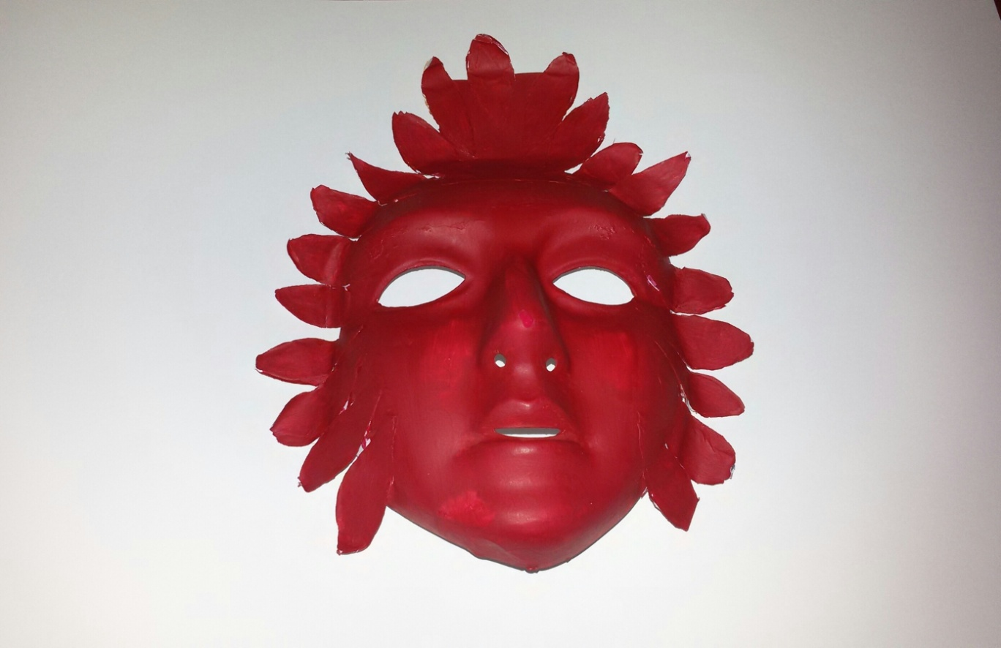
The Celtic Mask
The Celts lived in IV-III Century B.C. They settled in a wide area of Europe, from British Isles to the Danube basin. This population used the masks to scary people and to do spiritual rituals.

Slide 7
The masks have been realized by the students in class
3°H

